Slide 1
Respiration
Energy release in cells

Slide 2
Respiration
Energy release in cells
NOT
Gas exchange OR
Breathing

Slide 3
Energy Currency
Energy is stored in chemical bonds of food (e.g. glucose)
Inside cells glucose is broken down and the energy is transferred to ATP
ATP (adenosine triphosphate) carries energy within the cell to where it is needed
Adenosine
P
P
P
Tri-phosphate

Slide 4
The Energy cycle
Adenosine−P−P~P ⇔ Adenosine−P−P+ Energy +P
High energy bond
ATP
P
P
ENERGY
ENERGY
ADP
From respiration
For cell processes e.g. movement
(Adenosine diphosphate)

Slide 5
Respiration
Cellular respiration is a complex series of enzyme-controlled reactions in which food (e.g. glucose) is oxidised to release energy.
C₆H₁₂O₆ + 6O₂ → 6CO₂ + 6H₂O + Energy

Slide 6
4 Stages
Glycolysis in cytoplasm
  Glucose broken into two pyruvate molecules
Transition reaction – from cytoplasm to matrix of mitochondrion
  Acetyl coenzyme A made from pyruvate
Krebs Cycle in matrix of mitochondrion
  Acetyl group broken down releasing CO₂, hydrogen atoms and ATP
Electron transport chain – cristae
Hydrogen oxidised to water, much ATP made.

Slide 7
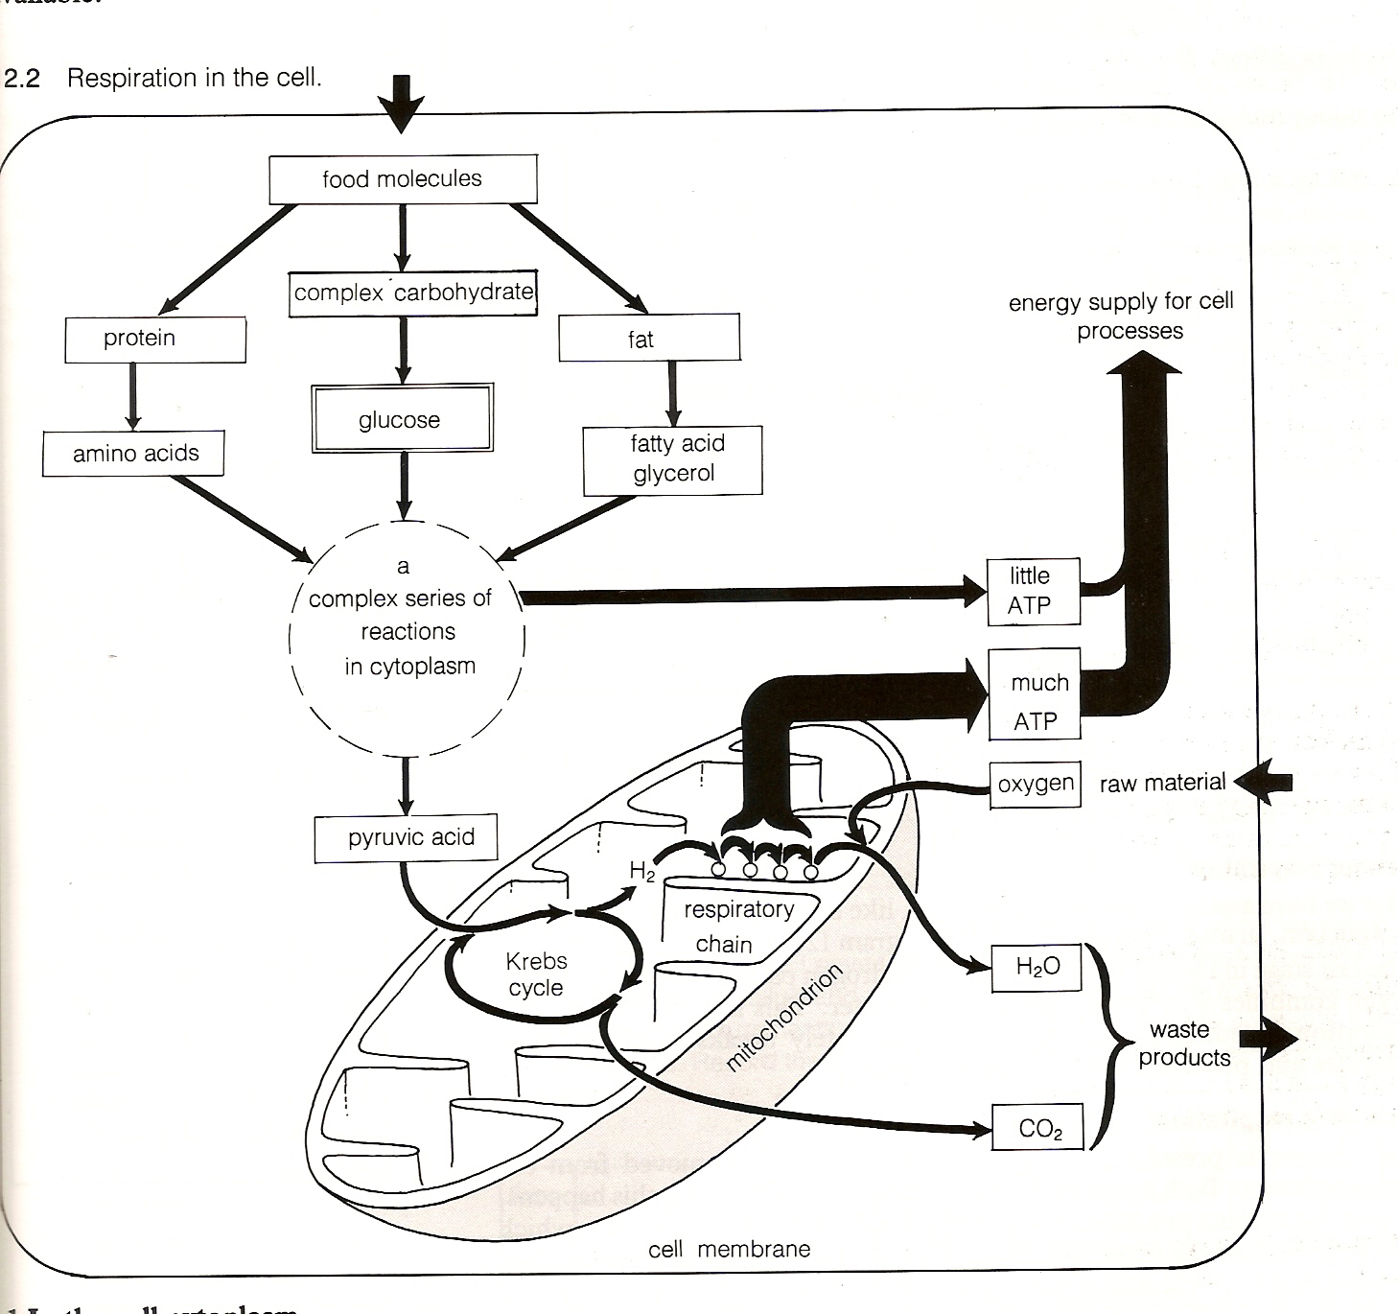

Slide 8
Anaerobic Respiration
When oxygen is used to complete respiration it is called aerobic respiration
Aerobic respiration produces H₂O, CO₂ and much ATP
If oxygen is NOT present, anaerobic respiration may occur
Anaerobic respiration produces different products and much less energy

Slide 9
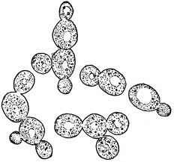
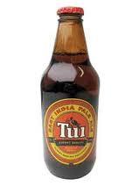
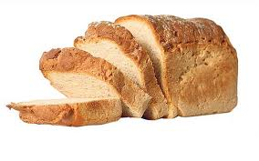
Alcohol Fermentation
Occurs in yeast and plants
Glycolysis starts, but without oxygen pyruvate is eventually converted to ethanol and carbon dioxide
This is used in bread making and brewing alcoholic drinks such as beer.
The alcohol builds up and eventually would kill the yeast

Slide 10
Lactic Acid Fermentation
This occurs in mammals
Glycolysis occurs but the pyruvate produced is converted into lactic acid
Lactic acid is harmful. This can continue for a while then the “oxygen debt must be repaid”.
In the liver, once oxygen is present some lactic acid is aerobically respired and the rest converted back to glucose.

Slide 11
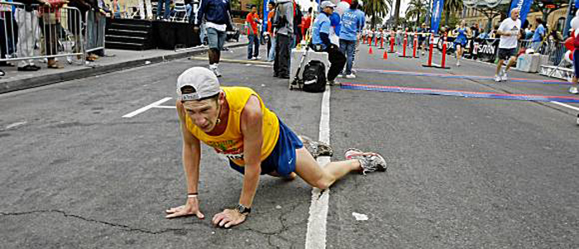
Too much lactic acid in the old leg muscles!

Slide 12
Photosynthesis
This is a complex set of reactions that occur in chloroplasts of plant cells
It transforms light energy into chemical energy stored in chemical bonds in food
Carbon dioxide and water are used.
Light Energy
6CO₂ + 12H₂O → C₆H₁₂O₆ + 6O₂ + 6H₂O
Chlorophyll

Slide 13
The Phases
Light dependent phase
Occurs in grana of chloroplast.
Light energy is used to make ATP and to split water molecules. Oxygen is released
Hydrogen is carried away by NADP
Light independent phase (“dark phase”)
Occurs in stroma of chloroplast.
Carbon dioxide is “fixed”, and combined with hydrogen and energy (in ATP) from the light phase to make glucose. This process is called the Calvin cycle.

Slide 14
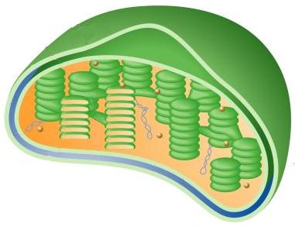
A Chloroplast
Light Phase
Water split,
O₂ released,
H carried to Calvin cycle by NADP,
ATP made
Grana
Stroma
CO₂ “fixed” during Calvin Cycle, Glucose made
Dark Phase

